Slide 1
Semi-supervised learning

Slide 2
Goal
Using both labeled and unlabeled data to build better learners

Slide 3
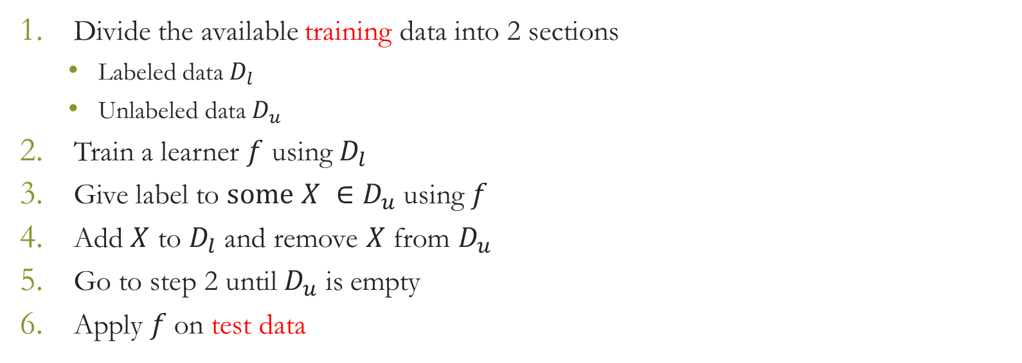
Steps

Slide 4
Assignment
Use ID3 decision tree learner with information gain for evaluation criterion
Divide the dataset as
Training data (80%)
Label data (50%)
Unlabeled data (50%)
Test data (20%)
At each step give label to 10% of the total unlabeled data

Slide 5
Comparison with Supervised learning
Run the experiment 10 times and take average values
Compare this learning method with the supervised decision tree learning method (1st Assignment) in terms of
Accuracy
Precision
Recall
F-measure
G-mean

